Slide 1
Guide to Computer Forensics and Investigations
Fifth Edition
Chapter 3
Data Acquisition
All slides copyright Cengage Learning with additional info from G.M. Santoro

Slide 2
Data Acquisition
Data acquisition is the process of copying data.
For digital forensics, it’s the task of collecting digital evidence from electronic media.
There are two types of data acquisition:
Static acquisitions
Live acquisition

Slide 3
The processes and data integrity requirements for static and live acquisitions are similar
Static Acquisition:
static acquisitions capture data that’s not accessed by other processes that can change.
if you have preserved the original media, making a second static acquisition should produce the same results. The data on the original disk isn’t altered, no matter how many times an acquisition is done
Live acquisitions:
file metadata, such as date and time values, changes when read by an acquisition tool. With static acquisitions
Making a second live acquisition while a computer is running collects new data because of dynamic changes in the OS.
Guide to Computer Forensics and Investigations Fifth Edition

Slide 4
Your goal when acquiring data for a static acquisition is to preserve the digital evidence.
Many times, you have only one chance to create a reliable copy of disk evidence with a data acquisition tool. Although these tools are generally dependable, you should still take steps to make sure you acquire an image that can be verified
Guide to Computer Forensics and Investigations Fifth Edition

Slide 5
Understanding Storage Formats for Digital Evidence
Data in a forensics acquisition tool is stored as an image file
Three formats
  Raw format
  Proprietary formats
  Advanced Forensics Format (AFF)
Guide to Computer Forensics and Investigations Fifth Edition
Notes:
The format will determine what you can do with the image.

Slide 6
Raw Format
bit-by-bit copy from one disk to another disk the same size or larger creating simple sequential flat files of a suspect drive or data set. The output of these flat files is referred to as a raw format.
Advantages
  Fast data transfers
  Ignores minor data read errors on source drive
  Most computer forensics tools can read raw format
Disadvantages
  Requires as much storage as original disk or data
  Tools might not collect marginal (bad) sectors
Guide to Computer Forensics and Investigations Fifth Edition
Notes:
Raw format is a direct bit-to-bit copy of the storage.

Slide 7
Proprietary Formats
Most forensics tools have their own formats
Features offered
  Option to compress or not compress image files
  Can split an image into smaller segmented files
  Can integrate metadata into the image file
  Metadata(date, time, hash value, examiner name, Investigator, comments)
Disadvantages
  Inability to share an image between different tools
  File size limitation for each segmented volume
The Expert Witness format is unofficial standard producing both compressed & uncompressed img files
These files have an extension starting with .E01 & incrementing it for additional img value
Notes:
More info on file formats may be found at
http://forensicswiki.org/wiki/Category:Forensics_File_Formats

Slide 8
Advanced Forensics Format
Developed by Dr. Simson L. Garfinkel as an open-source acquisition format
Design goals
  Provide compressed or uncompressed image files
  No size restriction for disk-to-image files
  Provide space in the image file or segmented files for metadata
  Simple design with extensibility
  Open source for multiple platforms and OSs
Guide to Computer Forensics and Investigations Fifth Edition

Slide 9
Advanced Forensics Format
Design goals (cont’d)
  Internal consistency checks for self-authentication
File extensions include .afd for segmented image files and .afm for AFF metadata
AFF is open source
Guide to Computer Forensics and Investigations Fifth Edition
Notes:
AFF4 is a complete redesign with many enhancements.

Slide 10
Determining the Best Acquisition Method
Types of acquisitions
  Static acquisitions and live acquisitions
Four methods of data collection
  Creating a disk-to-image file
  Creating a disk-to-disk
  Creating a logical disk-to-disk or disk-to-data file
  Creating a sparse data copy of a file or folder
Determining the best method depends on the circumstances of the investigation
Guide to Computer Forensics and Investigations Fifth Edition
Notes:
For example – in an e-mail investigation , sparse copies of server logs and specific mail (with headers) may suffice.

Slide 11
Determining the Best Acquisition Method
Creating a disk-to-image file
  Most common method and offers most flexibility
  Can make more than one copy
  Copies are bit-for-bit replications of the original drive
  ProDiscover, EnCase, FTK, SMART, Sleuth Kit, X-Ways, iLookIX
Creating a disk-to-disk
  When disk-to-image copy is not possible
  Several imaging tools can copy data exactly from an older disk to a newer disk.
  These programs can adjust the target disk’s geometry (its cylinder, head, and track configuration) so that the copied data matches the original suspect drive.
  EnCase, SafeBack, SnapCopy

Slide 12
Determining the Best Acquisition Method
Logical acquisition or sparse acquisition
  Collecting evidence from a large drive can take several hours
  Use when your time is limited
  Logical acquisition captures only specific files of interest to the case
  Sparse acquisition collects fragments of unallocated (deleted) data
  For large disks
  Eg for Email investigation->.pst or .ost mail files, RAID servers
Notes:
PST and OST are formats used by Microsoft.

Slide 13
Determining the Best Acquisition Method
When making a copy, consider:
  Size of the source disk
    Lossless compression might be useful
    Use digital signatures for verification
  When working with large drives, an alternative is using tape backup systems
  Whether you can retain the disk
Guide to Computer Forensics and Investigations Fifth Edition

Slide 14
Contingency Planning for Image Acquisitions
Create a duplicate copy of your evidence image file
Make at least two images of digital evidence
  Use different tools or techniques
Copy host protected area of a disk drive as well
  Consider using a hardware acquisition tool that can access the drive at the BIOS level
Be prepared to deal with encrypted drives
  Whole disk encryption feature in Windows called BitLocker makes static acquisitions more difficult
  May require user to provide decryption key
Guide to Computer Forensics and Investigations Fifth Edition
Notes:
There are many encryption tools available:
http://lifehacker.com/five-best-file-encryption-tools-5677725

Slide 15
Using Acquisition Tools
Acquisition tools for Windows
  Advantages
    Make acquiring evidence from a suspect drive more convenient
      Especially when used with hot-swappable devices
  Disadvantages
    Must protect acquired data with a well-tested write-blocking hardware device
    Tools can’t acquire data from a disk’s host protected area
    Some countries haven’t accepted the use of write-blocking devices for data acquisitions
Guide to Computer Forensics and Investigations Fifth Edition
Notes:
Write-blockers are essentially connectors with the write wire cut or non-existent. Making it physically impossible to accidentally write to the source drive.

Slide 16
Mini-WinFE Boot CDs and USB Drives
Mini-WinFE
  Enables you to build a Windows forensic boot CD/DVD or USB drive so that connected drives are mounted as read-only
Before booting a suspect’s computer:
  Connect your target drive, such as a USB drive
After Mini-WinFE is booted:
  You can list all connected drives and alter your target USB drive to read-write mode so you can run an acquisition program
Guide to Computer Forensics and Investigations Fifth Edition
Notes:
You can get WinFE at
https://winfe.wordpress.com/
Free online training for WinFE is located at:
http://courses.dfironlinetraining.com/windows-forensic-environment
Find mini-WinFE at:
http://mistype.reboot.pro/mini-winfe.docs/readme.files/quick.htm

Slide 17
Acquiring Data with a Linux Boot CD
Linux can access a drive that isn’t mounted
Windows OSs and newer Linux automatically mount and access a drive
Forensic Linux Live CDs don’t access media automatically
  Which eliminates the need for a write-blocker
Using Linux Live CD Distributions
  Forensic Linux Live CDs
    Contain additionally utilities
Guide to Computer Forensics and Investigations

Slide 18
Acquiring Data with a Linux Boot CD (continued)
Using Linux Live CD Distributions (continued)
  Forensic Linux Live CDs (continued)
    Configured not to mount, or to mount as read-only, any connected storage media
    Well-designed Linux Live CDs for computer forensics
      Helix
      Penguin Sleuth
      FCCU
Preparing a target drive for acquisition in Linux
  Linux distributions can create Microsoft FAT and NTFS partition tables
Guide to Computer Forensics and Investigations

Slide 19
Acquiring Data with a Linux Boot CD (continued)
Preparing a target drive for acquisition in Linux (continued)
  fdisk command lists, creates, deletes, and verifies partitions in Linux
  mkfs.msdos command formats a FAT file system from Linux
Acquiring data with dd in Linux
  dd (“data dump”) command
    Can read and write from media device and data file
    Creates raw format file that most computer forensics analysis tools can read
Guide to Computer Forensics and Investigations

Slide 20
Acquiring Data with a Linux Boot CD (continued)
Acquiring data with dd in Linux (continued)
  Shortcomings of dd command
    Requires more advanced skills than average user
    Does not compress data
  dd command combined with the split command
    Segments output into separate volumes
Acquiring data with dcfldd in Linux
  dd command is intended as a data management tool
    Not designed for forensics acquisitions
Guide to Computer Forensics and Investigations

Slide 21
dd if=/dev/sdb j split -b 650m - image sdb.
dcfldd if=/dev/sda of=usbimg.dat
Guide to Computer Forensics and Investigations

Slide 22
Acquiring Data with a Linux Boot CD (continued)
Acquiring data with dcfldd in Linux (continued)
  dcfldd additional functions
    Specify hex patterns or text for clearing disk space
    Log errors to an output file for analysis and review
    Use several hashing options
    Refer to a status display indicating the progress of the acquisition in bytes
    Split data acquisitions into segmented volumes with numeric extensions
    Verify acquired data with original disk or media data
Guide to Computer Forensics and Investigations

Slide 23
Capturing an Image with AccessData FTK Imager
Included on AccessData Forensic Toolkit
View evidence disks and disk-to-image files
Makes disk-to-image copies of evidence drives
  At logical partition and physical drive level
  Can segment the image file
Evidence drive must have a hardware write-blocking device
  Or the USB write-protection Registry feature enabled
FTK Imager can’t acquire drive’s host protected area
Guide to Computer Forensics and Investigations

Slide 24
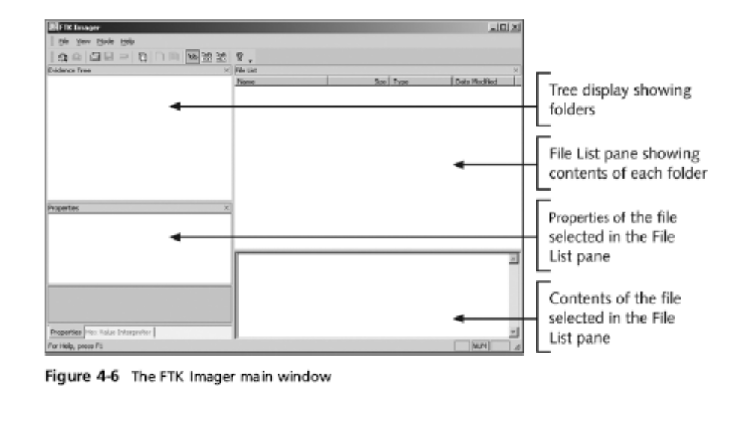
Capturing an Image with AccessData FTK Imager (continued)
Guide to Computer Forensics and Investigations

Slide 25
Capturing an Image with AccessData FTK Imager (continued)
Steps
  Boot to Windows
  Connect evidence disk to a write-blocker
  Connect target disk to write-blocker
  Start FTK Imager
  Create Disk Image
    Use Physical Drive option
Guide to Computer Forensics and Investigations

Slide 26
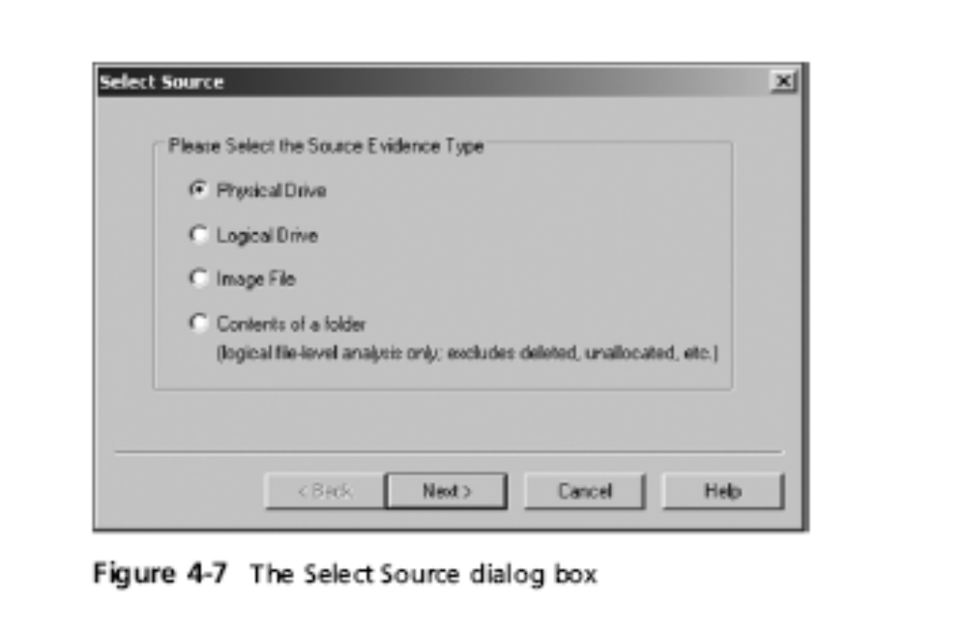
Capturing an Image with AccessData FTK Imager (continued)
Guide to Computer Forensics and Investigations

Slide 27
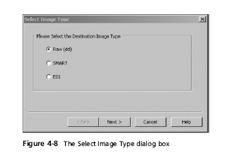
Capturing an Image with AccessData FTK Imager (continued)
Guide to Computer Forensics and Investigations

Slide 28
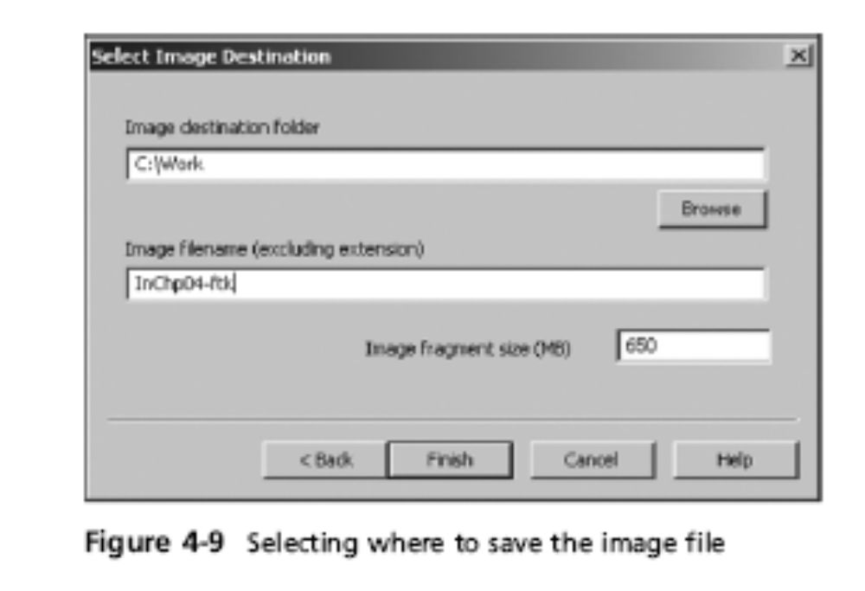
Capturing an Image with AccessData FTK Imager (continued)
Guide to Computer Forensics and Investigations

Slide 29
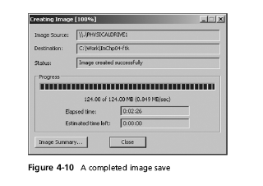
Capturing an Image with AccessData FTK Imager (continued)
Guide to Computer Forensics and Investigations

Slide 30
Validating Data Acquisitions
Most critical aspect of computer forensics
Requires using a hashing algorithm utility
Validation techniques
  CRC-32, MD5, and SHA-1 to SHA-512
Guide to Computer Forensics and Investigations

Slide 31
Linux Validation Methods
Validating dd acquired data
  You can use md5sum or sha1sum utilities
  md5sum or sha1sum utilities should be run on all suspect disks and volumes or segmented volumes
Validating dcfldd acquired data
  Use the hash option to designate a hashing algorithm of md5, sha1, sha256, sha384, or sha512
  hashlog option outputs hash results to a text file that can be stored with the image files
  vf (verify file) option compares the image file to the original medium
Guide to Computer Forensics and Investigations

Slide 32
md5sum/dev/sdb>md5 sdb.txt
dcfldd if=/dev/sda split=2M of=usbimg hash=md5
Hashlog=usbhash.log
Guide to Computer Forensics and Investigations

Slide 33
Windows Validation Methods
Windows has no built-in hashing algorithm tools for computer forensics
  Third-party utilities can be used
Commercial computer forensics programs also have built-in validation features
  Each program has its own validation technique
Raw format image files don’t contain metadata
  Separate manual validation is recommended for all raw acquisitions
Guide to Computer Forensics and Investigations

Slide 34
Using Remote Network Acquisition Tools
You can remotely connect to a suspect computer via a network connection and copy data from it
Remote acquisition tools vary in configurations and capabilities
Drawbacks
  LAN’s data transfer speeds and routing table conflicts could cause problems
  Gaining the permissions needed to access more secure subnets
  Heavy traffic could cause delays and errors
Guide to Computer Forensics and Investigations

Slide 35
Remote Acquisition with ProDiscover
With ProDiscover Investigator you can:
  Preview a suspect’s drive remotely while it’s in use
  Perform a live acquisition
  Encrypt the connection
  Copy the suspect computer’s RAM
  Use the optional stealth mode
ProDiscover Incident Response additional functions
  Capture volatile system state information
  Analyze current running processes
Guide to Computer Forensics and Investigations

Slide 36
Remote Acquisition with ProDiscover (continued)
ProDiscover Incident Response additional functions (continued)
  Locate unseen files and processes
  Remotely view and listen to IP ports
  Run hash comparisons
  Create a hash inventory of all files remotely
PDServer remote agent
  ProDiscover utility for remote access
  Needs to be loaded on the suspect
Guide to Computer Forensics and Investigations

Slide 37
Remote Acquisition with ProDiscover (continued)
PDServer installation modes
  Trusted CD
  Preinstallation
  Pushing out and running remotely
PDServer can run in a stealth mode
  Can change process name to appear as OS function
Guide to Computer Forensics and Investigations

Slide 38
Remote Acquisition with ProDiscover (continued)
Remote connection security features
  Password Protection
  Encryption
  Secure Communication Protocol
  Write Protected Trusted Binaries
  Digital Signatures
Guide to Computer Forensics and Investigations

Slide 39
Remote Acquisition with EnCase Enterprise
Remote acquisition features
  Remote data acquisition of a computer’s media and RAM data
  Integration with intrusion detection system (IDS) tools
  Options to create an image of data from one or more systems
  Preview of systems
  A wide range of file system formats
  RAID support for both hardware and software
Guide to Computer Forensics and Investigations

Slide 40
Remote Acquisition with R-Tools R-Studio
R-Tools suite of software is designed for data recovery
Remote connection uses Triple Data Encryption Standard (3DES) encryption
Creates raw format acquisitions
Supports various file systems
Guide to Computer Forensics and Investigations

Slide 41
Remote Acquisition with Runtime Software
Utilities
  DiskExplorer for FAT
  DiskExplorer for NTFS
  HDHOST
Features for acquisition
  Create a raw format image file
  Segment the raw format or compressed image
  Access network computers’ drives
Guide to Computer Forensics and Investigations

Slide 42
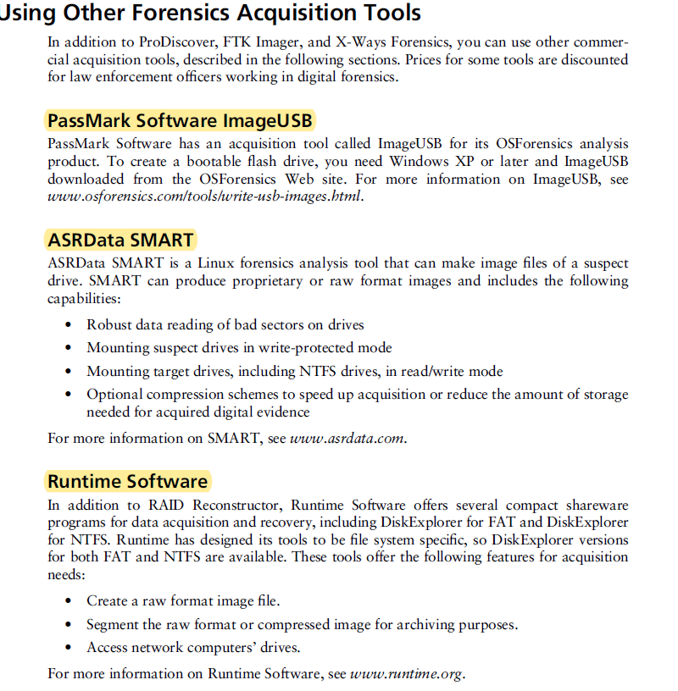

Slide 43
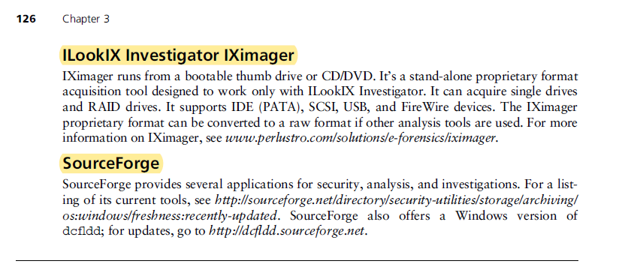
Guide to Computer Forensics and Investigations

